Slide 1

Automating Risk Aggregation: A Transformative Approach
In an era of accelerating change and interconnected global markets, effective risk management is paramount. This presentation outlines a strategic program to transform our manual risk aggregation processes into an automated, data-driven system, leveraging our proprietary DataConnect tool. Our objective is to enhance decision-making, improve operational efficiency, and establish a robust, future-ready risk intelligence framework.

Slide 2
Agenda
Strategic Overview of Risk Transformation
01
02
The Challenge: Manual Risk Aggregation
Vision: Automated Risk Intelligence
Understanding the limitations and inefficiencies of our current state.
Defining the strategic objectives and benefits of a transformed process.
03
04
Introducing DataConnect: Our Core Enabler
Program Roadmap & Key Milestones
Highlighting the capabilities and advantages of our in-house tool.
A phased approach to implementation and expected deliverables.
05
06
Enhanced Reporting & Decision Support
Impact & Path Forward
Leveraging new capabilities for actionable insights.
Quantifying the benefits and outlining next steps for executive sponsorship.

Slide 3

Chapter 1
The Challenge: Manual Risk Aggregation
Our current risk aggregation processes, while diligent, are heavily reliant on manual data collection, consolidation, and analysis. This approach, though functional, introduces significant challenges that impede our agility and effectiveness in a rapidly evolving risk landscape.
Time-consuming data collection from disparate sources.
High potential for human error in data entry and calculation.
Lack of real-time visibility into emerging risks.
Inconsistent methodologies across different departments.
Limited capacity for granular analysis and predictive modeling.
Delayed reporting impacting proactive decision-making.
"Our current risk data is a snapshot, not a live feed. We need to move from reactive mitigation to proactive intelligence."
— Internal Risk Assessment Report, Q3 2023

Slide 4






Chapter 2
Vision: Automated Risk Intelligence
Our vision is to establish a comprehensive, automated risk intelligence ecosystem that provides real-time, consolidated, and actionable insights across the enterprise. This transformation will empower us to anticipate, assess, and respond to risks with unprecedented speed and accuracy, fostering a culture of informed decision-making.
Real-time Visibility
Enhanced Accuracy
Granular Insights
Access to up-to-the-minute risk data and dashboards.
Minimizing human error through automated data ingestion and processing.
Ability to drill down into specific risk factors and trends.
Predictive Capabilities
Holistic View
Leveraging historical data to forecast potential future risks.
Aggregated risk profile across all business units and geographies.

Slide 5

Chapter 3
Introducing DataConnect: Our Core Enabler
At the heart of this transformation lies DataConnect, our proprietary in-house tool engineered to streamline data integration and reporting. DataConnect is not merely a reporting tool; it's an intelligent data aggregation engine designed for scalability, security, and precision.
Automated Data Ingestion: Connects to various source systems (financials, operations, IT, compliance) to automatically pull risk-related data, eliminating manual exports and imports.
Intelligent Data Mapping: Utilizes pre-defined rules and AI-assisted mapping to standardize and categorize disparate data formats into a unified risk taxonomy.
Real-time Aggregation Engine: Processes and aggregates data on a continuous basis, providing live updates to our risk dashboards and reports.
Customizable Reporting Module: Allows for the creation of bespoke risk reports tailored to specific executive needs, regulatory requirements, or departmental views.
Secure & Scalable Infrastructure: Built on a robust, cloud-native architecture ensuring data integrity, confidentiality, and the ability to handle growing data volumes.
DataConnect: Bridging the Gap Between Raw Data and Strategic Insight

Slide 6
Chapter 4
Program Roadmap & Key Milestones
The risk aggregation automation program will be implemented in a phased approach, ensuring a controlled rollout and continuous value delivery. Each phase includes specific objectives and key deliverables, designed to build capabilities incrementally.
Phase 1: Foundation (Q1-Q2)
Phase 3: Optimization & Predictive (Q1+ Next Year)
DataConnect setup & core module integration.
Advanced analytics and machine learning integration for predictive risk insights.
Onboarding of initial risk data sources (e.g., operational risk logs, financial risk data).
Enhanced scenario modeling capabilities.
Integration with external market data feeds for real-time threat intelligence.
Establishment of standardized risk taxonomy.
Continuous improvement and feature enhancements based on user feedback.
Pilot automated daily risk aggregation for a key business unit.
1
2
3
Phase 2: Expansion (Q3-Q4)
Integration of additional risk domains (e.g., IT risk, compliance risk, market risk).
Rollout of DataConnect to all relevant departments.
Development of initial custom executive dashboards.
Training program for risk managers and analysts.
Regular stakeholder reviews will be conducted at the end of each phase to ensure alignment and address any emerging requirements.

Slide 7
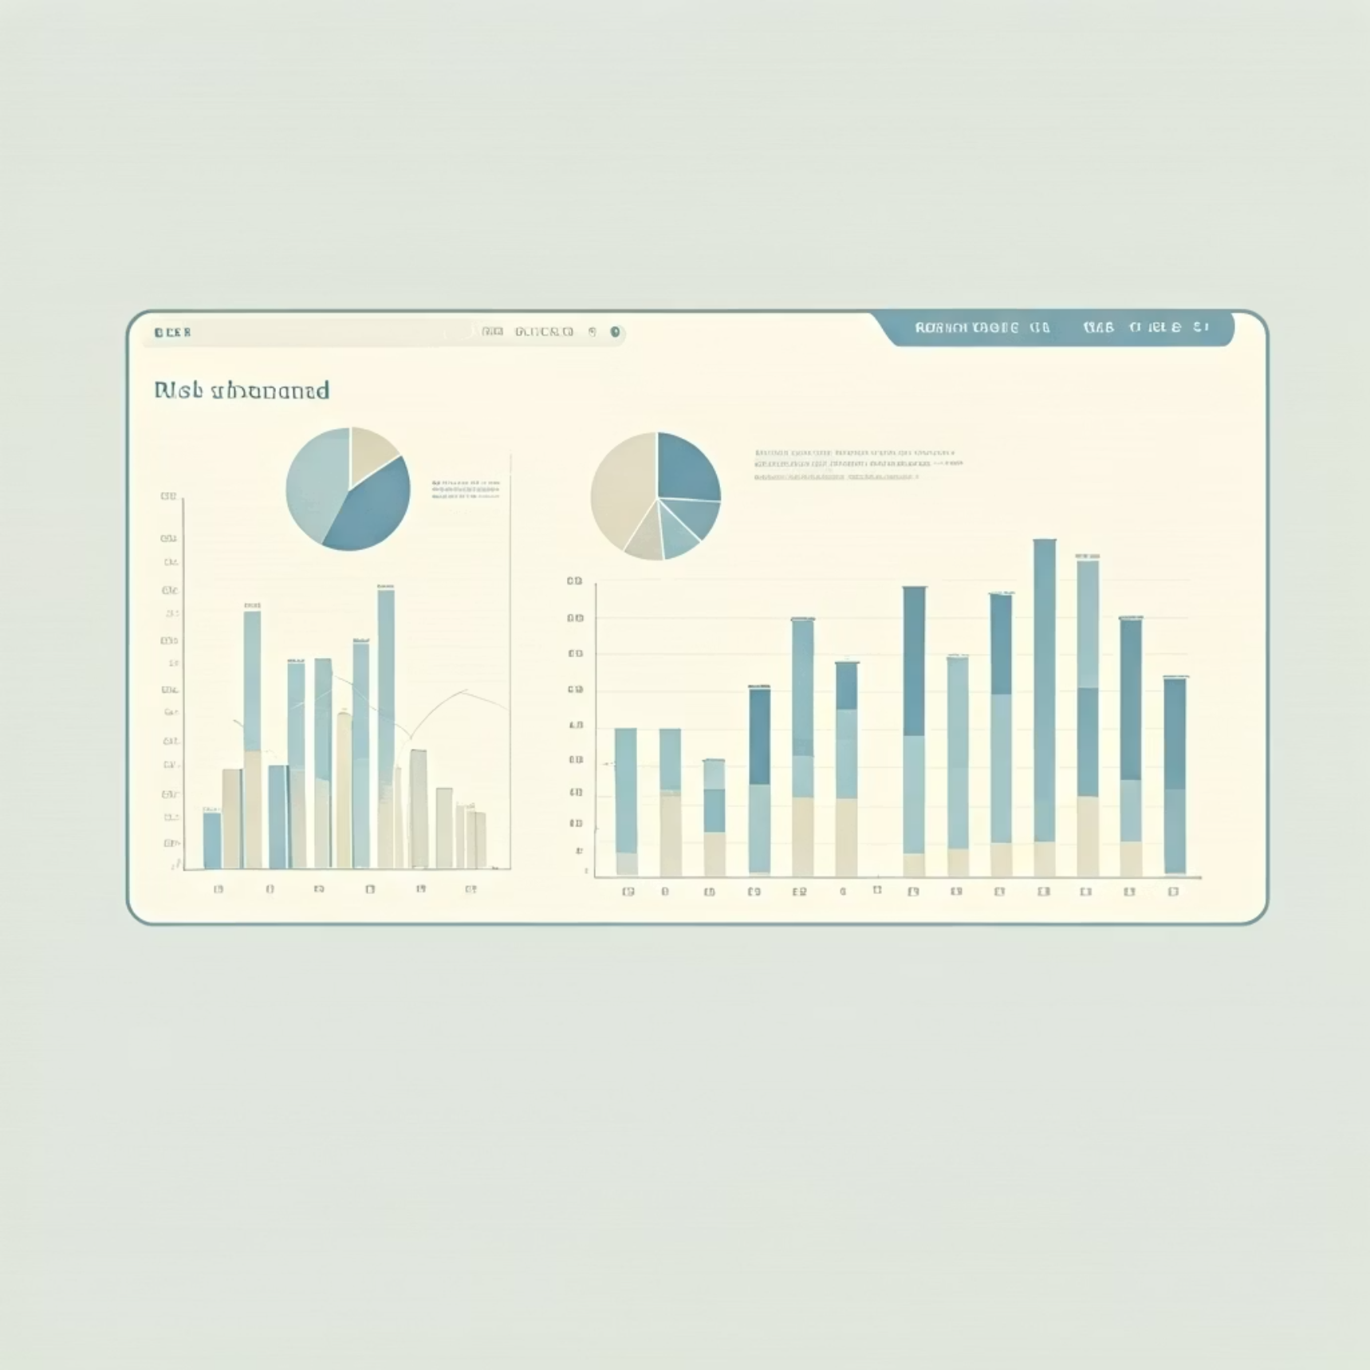
Chapter 5
Enhanced Reporting & Decision Support
The primary benefit of this transformation is the evolution of our reporting capabilities from static, backward-looking reports to dynamic, forward-looking decision support tools. Leveraging DataConnect, we will introduce a suite of new reports designed for executive-level insights.
Executive Risk Dashboard: A concise, real-time overview of the organization's top risks, emerging threats, and mitigation progress.
Scenario Analysis Reports: Tools to model the impact of various risk events and test the efficacy of different response strategies.
Heatmap Visualizations: Interactive heatmaps providing a quick visual assessment of risk exposure by business unit, category, or geography.
Trend & Predictive Reports: Analysis of historical risk data to identify trends and forecast potential future risk concentrations.
Compliance & Regulatory Reporting: Automated generation of reports that meet specific regulatory requirements, ensuring adherence and reducing manual effort.
Operational Efficiency Metrics: Insights into the time and resources saved through automated processes, demonstrating ROI.

Slide 8
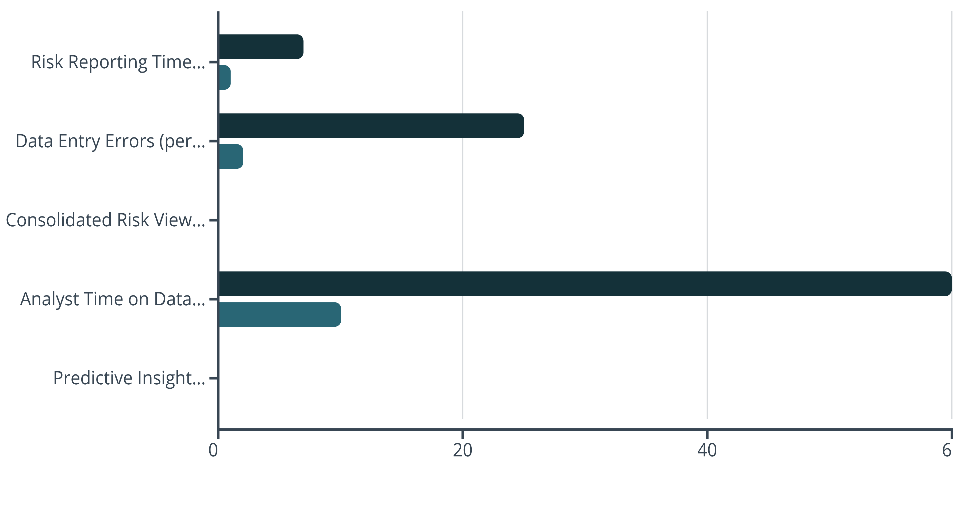
Chapter 6
Key Metrics: Before & After Automation
Automating risk aggregation with DataConnect is projected to yield significant improvements across several key performance indicators:
Current State (Manual)
Target State (Automated)
This transformation is not just about efficiency; it's about shifting our risk function from a clerical role to a strategic foresight partner.

Slide 9








Executive Summary: The Strategic Imperative
The transition to automated risk aggregation using DataConnect represents a critical strategic imperative for our organization. It addresses current inefficiencies, enhances our capacity for proactive risk management, and establishes a robust foundation for future growth and resilience.
Unified Risk View
Enhanced Agility
Consolidate disparate risk data into a single, comprehensive platform.
Accelerate risk identification and response with real-time data.
Stronger Governance
Operational ROI
Improve data accuracy, consistency, and auditability for compliance.
Free up valuable analyst time for higher-value strategic analysis.
This program will transform our risk function from a cost center to a value driver, directly contributing to organizational stability and strategic decision-making.

Slide 10

Path Forward & Call to Action
To successfully implement this transformative program, we seek the executive sponsorship and strategic alignment necessary to drive its success. Our team is prepared to move forward immediately with the foundational phase.
Next Steps:
Executive Endorsement: Secure formal approval and resource allocation for Phase 1.
Cross-Functional Steering Committee: Establish a committee with representation from Risk, IT, Operations, and Key Business Units to oversee implementation.
Detailed Implementation Planning: Finalize the detailed project plan, including specific resource requirements and timelines for Q1-Q2.
Pilot Project Kick-off: Initiate the DataConnect setup and pilot integration for the selected business unit.
Your leadership will be instrumental in enabling this critical step towards a more resilient and data-driven future.

